Slide 1
STEP OVERVIEW PRESENTATION
TAKING THE NEXT S.T.E.P. IN SAFETY

Slide 2
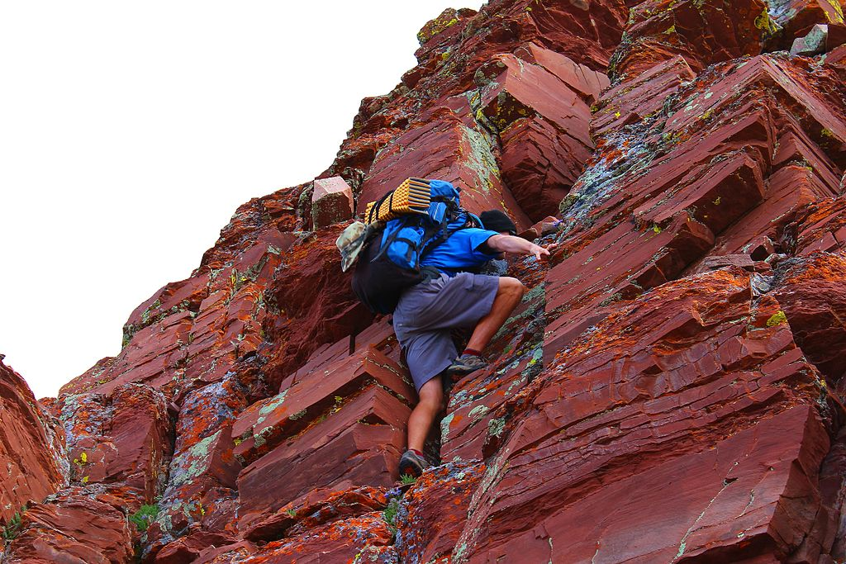
Our next STEP in Safety? Hmmmmmmm!
Notes:
Have you ever stopped to think about your next step in safety?

Slide 3

People Power Safety

Slide 4
AGENDA
STEP PURPOSE
STEP VISION
DEFINITIONS
STEP PROCESS ELEMENTS
EXPECTATIONS
STEP CHECKLISTS
STEP ACTIONS
CONCLUSION

Slide 5
PURPOSE
We will achieve… Safety Through Everyone's Participation.
We will do this through actively engaging the department staff, contractors, and their craft to look out for the health and safety of each other.
We will identify and prevent situations that could result in serious injury or the loss of a life.
This information will be communicated on a regular bases with solutions and fixes.
We will strive to have better safety conversations

Slide 6
STEP VISION
To create a dependable, repeatable method to measure safety success using leading indicators instead of solely relying on RIR.

Slide 7

DEFINITIONS
Lagging Indicators
Measuring an organization’s safety performance based on historical loss information
Examples:
OSHA Recordable Incidence Rates
Lost Workday Case Rates
First Aid cases
Near Misses

Slide 8

DEFINITIONS
Leading Indicators
Measurable factors of performance that may indicate a particular direction or trend
Examples:
Job Hazard Analyses / Job Safety Analyses
Observations
Employee Perception/Safety Culture Survey
Training Completion and Effectiveness

Slide 9
PROCESS ELEMENTS
STEP
Process Elements
Culture
Human Performance
Engagement
Leadership
Communication
Leading Indicators
Notes:
These are the STEP Process Elements…..It starts with the culture. It involves Human Performance, Engagement, Leadership from all levels, Communication and Leading Indicators.
Culture is what we do as an organization. Organizational culture impacts the organization in many ways. It is the unwritten rules. Some changes come quickly like a new CEO as where other changes evolve over time and is planned out. So to change culture we need to focus on other elements to help create the needed momentum.
Human Performance is why we do what we do.
Engagement is getting employees and craft to own safety. Engagement is necessary from all levels for success.
Leadership is inspiring people to be safety champions.
Communication poses the most issues. Its having the courage and consideration to communicate. How do we communicate information?
Lastly leading indicators are measurable factors that may indicate a direction or trend.

Slide 10
EXPECTATIONS
Organizational Level:
Create a “shared leadership safety culture” though the new process.
Provide all levels of employees with the same “Safety Philosophy.”
Supply all employees with time and resources to make a difference.
Give employees common tools to increase their safety effectiveness.
Notes:
To make the next STEP in our culture change, we need to commit to these new tools and ideas from the organizational level and from the personal level. Culture where we are looking out for each other. An apprentice should be able to approach a 30 year veteran and bring up at risk behaviors/safety issues.

Slide 11
EXPECTATIONS
Personal Level:
Commit to using new tools to improve your own safety culture.
Use new safety communication tools to reinforce the culture change.
Examine your own safety leadership behaviors to ensure success.
Engage other employees to help create safety momentum.
Notes:
A culture where we are looking out for each other. An apprentice should be able to approach a 30 year veteran and bring up at risk behaviors/safety issues.

Slide 12
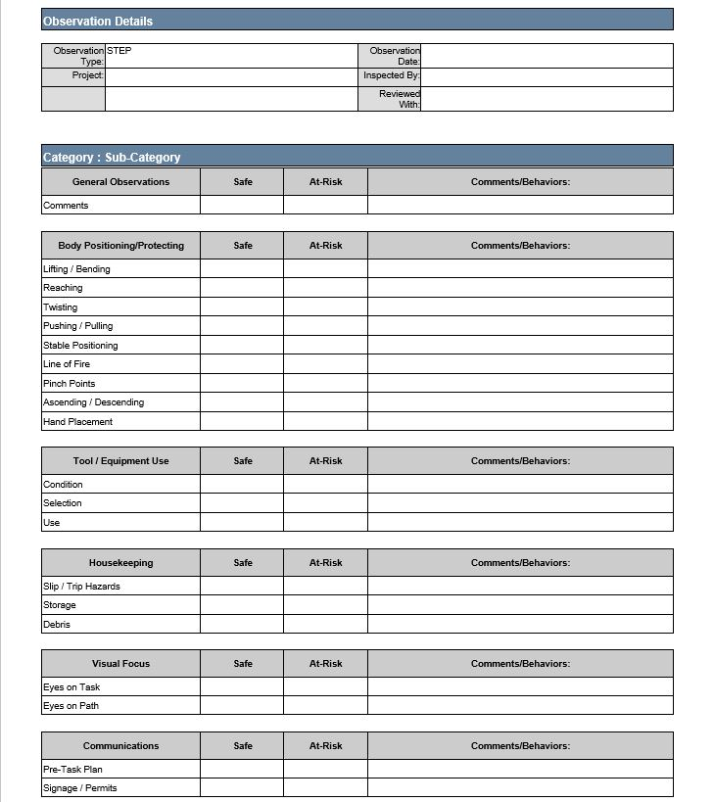
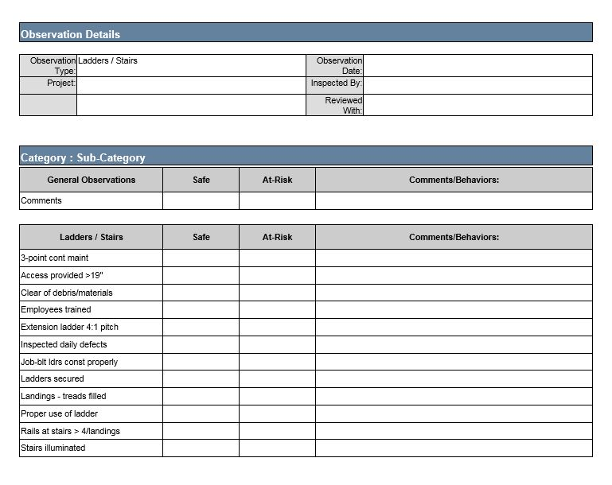
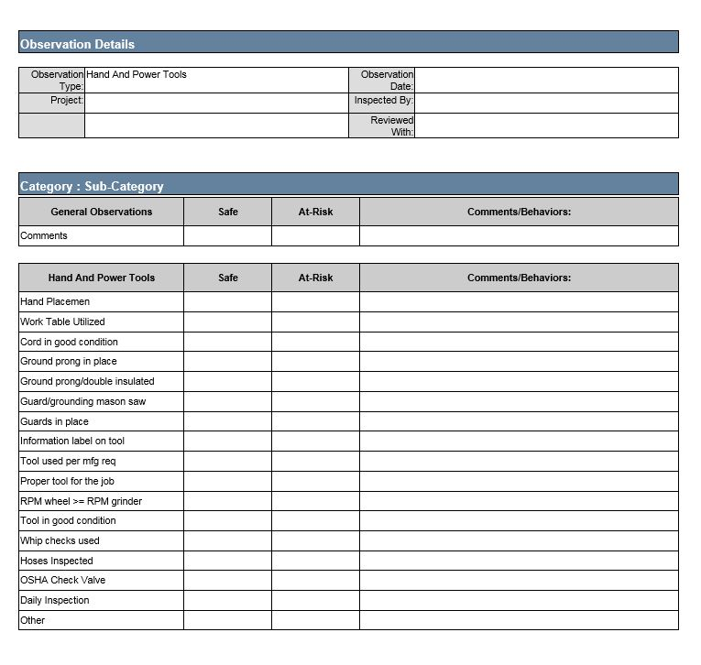
CHECKLISTS
Notes:
Review how to use the STEP checklist.

Slide 13
STEP ACTIONS
Consistently conduct STEP observations
Begin craft participation through Safety Teams
Monitor observation quality
Communicate data to everyone in the department
Improve contractor engagement
Improve Leadership engagement conversations
Focused observations based on the data and upcoming work activities
Reduce probability of serious injuries & fatalities

Slide 14

We Need to STOP
Reacting to Injuries…
CONCLUSION
And START
Predicting Them!

Slide 15

We Still Have Work to Do…
People Power Safety

